Slide 1
caArray User Community Meeting
Upcoming releases and demo of new functionality
Call in: 877-416-5524
Participant Passcode: 2627056
Centra: http://ncicb.centra.com
Meeting ID: ICR_meeting
October 1, 2008

Slide 2
Agenda
Status of upcoming release: 2.1.1
Update on next major release: 2.2.0
  Demonstration of sample characteristics-based search prototype
Migration to Knowledge Center Resources
Request for feedback

Slide 3
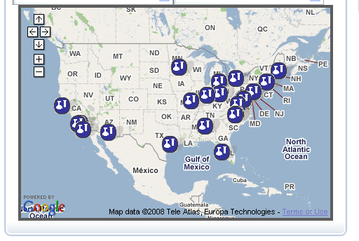
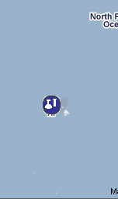
24 caArray nodes on caGrid!
(Hawaii)

Slide 4
Upcoming Release: 2.1.1
Schedule
  Anticipated release approximately October 15.
Scope of 2.1.1
  Affymetrix Exon arrays: Parse .PGF and .CLF files for array design import to support Affymetrix Exon arrays and any other array designs that use these formats.
  Additional items:
    [#15416] Intermittent failure to import large sets of data files after successful validation
    [#15164] Disallow Import of Extra Data Files not in MAGE-TAB
    [#15165] Make Manage Data page more usable by sorting, filtering and providing counts
Detailed Scope:
  Implementation Items Tracker: New Gforge tracker replaces Defect tracker and Feature Request tracker.
  Filter tracker items by target_release=2.1.1 for detailed visibility into total scope:
  https://gforge.nci.nih.gov/tracker/?atid=1344&group_id=305&func=browse

Slide 5
Key items currently scoped for 2.2.0
[#14162] Implement search for biomaterials (demo to follow)
  Search criteria = biomaterial annotations
  Results = Samples or Experiments
[#15409] Improve usability of the Experiment Permissions UI for sample-selective access control.
[#16411] Incremental bulk-update of biomaterial characteristics
[#16627] Provide MAGE-TAB export of an experiment
[#13122] Display Experiment Factor Values in the user interface
[#13237] Expand/re-evaluate the Assay Type list
[#13238] Remove restriction of one assay type per array design

Slide 6
In progress, for post-2.2.0 release:
[#15168] Secure access through the Grid API
[#15578] Redesign of programmatic API
  Paving the way for backwards compatibility
  Transitioning all users to the Grid API
  Rich set of caGRID analytical services to provide a quick and convenient way to get to data of interest (avoiding tedious traversal of domain object graph).
[#14969] Illumina support
  Parsing of Group Probe Profile files.
  Parsing of .bgx array design format.

Slide 7
Demo: Biomaterials Search

Slide 8
caArray Users and Developers Listserv Migration
Goal: Finalize the migration of the caArray Users and Developers listserv activity to the MAT-KC Forum
  Advantages: Threaded discussions, easy access to archival discussions, searchable.
Plan to complete this migration by Friday, October 31, 2008. After this date, all community postings must be to the MAT-KC Forum. Posting to the listservs will be disabled.
Important product announcements will still be broadcast over the listserv.
You can subscribe to the forums (fora?) and receive emails of the postings – mimics the listserv behavior.

Slide 9
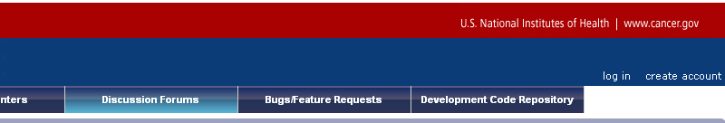
Subscribing to the forum: Get an account
1. Go to https://cabig-kc.nci.nih.gov/Molecular/KC/ and click on “create account” in the upper right corner:
Or go directly to http://wikiutils.nci.nih.gov/KC_signup
Your KC username and password will be emailed to you within 1 business day

Slide 10
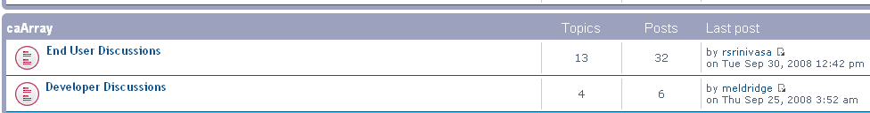
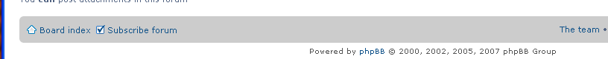
Subscribing to the forum: Login and subscribe
2. Login to the forum
3. Click on the board(s) of interest
4. Go to the very bottom of the page and click on “Subscribe forum”

Slide 11
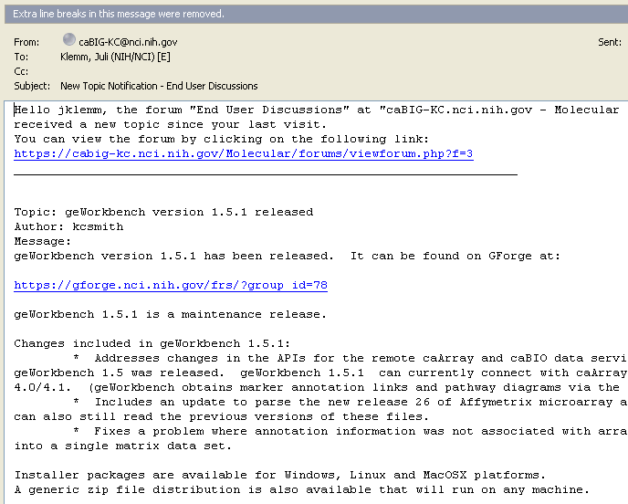
You will now be emailed forum postings

Slide 12
Avenues for Feedback
Molecular Analysis Knowledge Center Forum
  We welcome and encourage active exchanges on the forums to share experiences with the product
MAT-KC Bugzilla tracker will be rolled out next. You may continue to use the GForge Community Change Request tracker until then:
  http://gforge.nci.nih.gov/tracker/?atid=1339&group_id=305&func=browse
This meeting
Next Meeting:
Wednesday, November 5, 2:00 PM ET

